Slide 1
Final Proj A
Brendan O’Connor

Slide 2
Approach
Due to the number of potential parameters to optimize d’ we took a greedy approach to finding an optimal d’. As a result we hold no pretense this is the optimal configuration. Additionally, we downsampled all of the images to decrease computational cost.

Slide 3
Approach
The order that the parameters were selected were as follows: number of layers and the size of each layer, L2 parameters, and SR parameters. The results can be found in the following files, respectively.
LayerExperiments.csv
l2Results.csv
srResults.csv

Slide 4
Results
We found the best performing configuration to be a 2 layer autoencoder with
layer 1 = 400
Layer 2 = 100
Layer 1 L2 = .004
Layer 2 L2 = .003
Layer 1 SR = .3
Layer 2 SR = .5
Max d’ = 2.4149

Slide 5
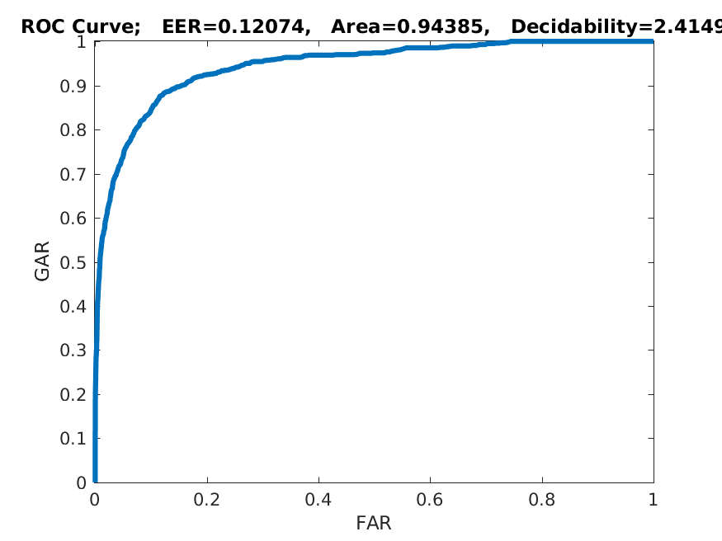
Results - Best ROC

Slide 6
Results - Discussion
We see from the ROC that we ended up getting pretty good results AUC = .943 this indicates the AE was pretty well able to create a high level representation of the images (even after being down sampled)
In also looking at the ROC curve it is pretty “smooth” or “round” indicating you “get” a healthy amount of performance increase for every incremental decrease in the threshold

